Slide 1
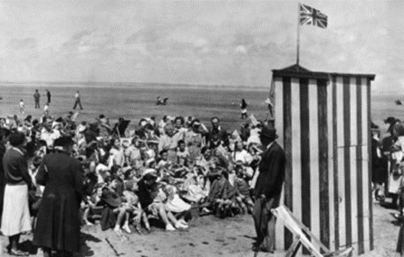
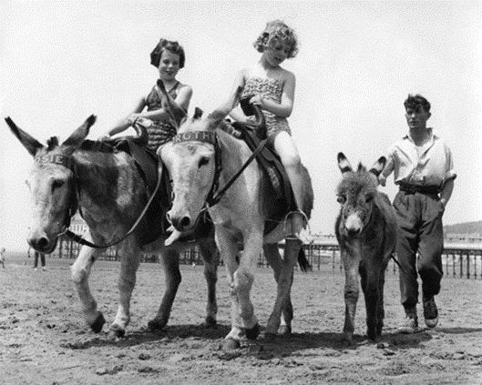
Key Vocabulary
Different
Holidays
Questions
Where did grandma go on holiday as a child?
What can a photograph tell us about seaside holidays in the past?
What can souvenirs tell us about seaside holidays in the recent past?
What can stories tell us about seaside holidays in the recent past?
Where all holidays the same when our grandparents were children?
Different | Not the same as something.
Same | Things are identical, the opposite to different.
Holidays | Time spent away from home, enjoying leisure time.
Resort | A place where people say on holiday.
Souvenir | A thing that is kept as a reminder of a holiday.
Key Takeaways
People began to go on seaside holidays when they started to get paid more money at work. In the 1950s, people also began to get more holiday time from work. People travelled to the seaside by train or coach. A few people used a car. Most people went on holiday in the United Kingdom. Some went to holiday resorts such as Butlins or Pontins. Some things about holidays are the same and some are different from the past. Not everyone went to the seaside. Some people went camping in the countryside and some people stayed at home. We can find out about the past by looking at postcards sent to friends and family. We can also ask people about their holidays. And we can look at objects people have brought back from their holiday, called ‘souvenirs’. We can look at the photographs that people took on holiday too.
Holidays in the 1950s.
Children watching Punch and Judy shows.
Timeline

