Slide 1
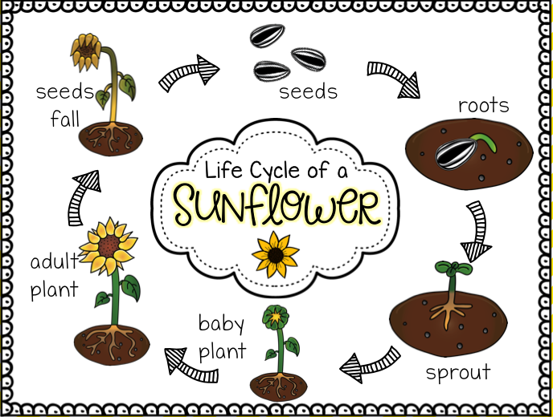
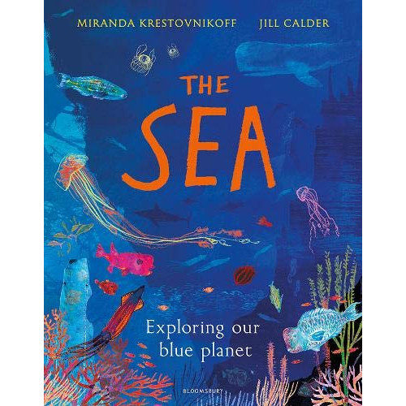
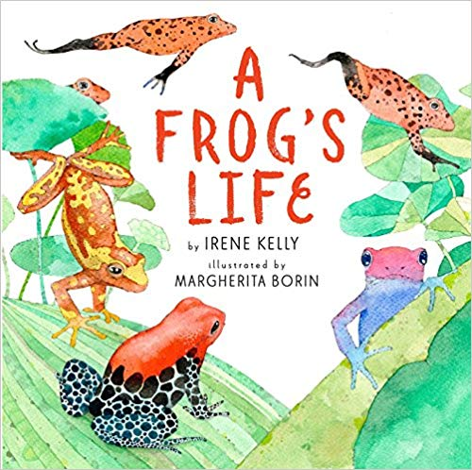
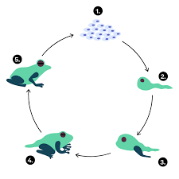
Year 5: Life Cycles Knowledge Organiser
Subject Specific Vocabulary |  | Interesting Books
asexual/sexual | All living things reproduce. Reproduction can happen both asexually and sexually. Sexual reproduction happens when two organisms reproduce together. Asexual reproduction happens when an individual creates another individual by themselves.
gestation | Gestation, in mammals, is the time between conception and birth, during which the embryo is developing in the uterus.
classification | This is the grouping together of similar species of plant, animal and other organisms.
precision | For scientists, precision describes a measurement system, that is, how reliable it is at giving the same result every time it measures the same thing.
reproduction | Reproduction is the way different plants and animals make new plants and animals. The reproduction system differs in plants and animals.
 |  | Important facts to know by the end of the all living things topic:
respiration | Respiration is done by all living things. Living things release energy from their food by respiration. Many organisms need oxygen to do this. | Know the difference between sexual and asexual reproduction. Know the differences between different life cycles. Know the process of reproduction in plants. Know the process of reproduction in animals. Know the 7 life processes.
excretion | Excretion is the removal of unneeded things from a living organism. Waste products are removed from the body. Both plants and animals have to get rid of excess gas and water.
pollination | Pollination is needed for the reproductive cycle of a plant. It can occur via many different ways such as wind or insects.
embryo | Fertilisation happens when an egg cell meets with a sperm cell and joins with it. The fertilised egg divides to form a ball of cells called an embryo.

